Slide 1
Java Basics
Unit test and Eclipse general skills and practice
Java workshop training, August,2017.
Dr. Kishore Biswas (Forrest/柯修)
PhD. Artificial Intelligence—Natural Language Processing.
CanWay IT Training ®.

Slide 2
Contents
1) Unit test
2) Eclipse general skills and practice

Slide 3
1) Unit test

Slide 4
Definition
A unit test:
is a piece of a code (usually a method) that invokes another piece of code.
checks the correctness of some assumptions afterward.
if the assumptions turn out to be wrong, the unit test has failed.
A “unit” is a method or function.

Slide 5
The importance of writing “good” unit tests
Most people who try to unit-test their code either give up at some point or don’t actually perform unit tests.
Instead, they either
rely on system and integration tests to be performed much later in the product lifecycle
or they resort to manually testing the code via custom test applications or by using the end product they’re developing to invoke their code.
That’s either too late to correct the error or very difficult to do so.

Slide 6
Properties of a good unit test
A unit test should have the following properties:
It should be automated and repeatable.
It should be easy to implement.
Once it’s written, it should remain for future use.
Anyone should be able to run it.
It should run at the push of a button.
It should run quickly.

Slide 7
A more comprehensive definition of Unit Test
A unit test is an automated piece of code that invokes the method or class being tested.
and then checks some assumptions about the logical behavior of that method or class.
A unit test is almost always written using a unit-testing framework (e.g. NUnit, JUnit)
It can be written easily and runs quickly.
It’s fully automated, trustworthy, readable, and maintainable.

Slide 8
Unit-testing frameworks are code libraries and modules that help developers unit-test their code, as outlined in the following table.
unit-testing frameworks help developers write and execute tests, and review results
Unit-testing practice | How the framework helps
Write tests easily and in a structured manner. | Framework supplies the developer with a class library that holds: base classes or interfaces to inherit. attributes to place in your code to note your tests to run. assert classes that have special assert methods you invoke to verify your code.
Execute one or all of the unit tests. | Framework provides a test runner (a console or GUI tool) that : identifies tests in your code. runs tests automatically. indicates status while running. can be automated by command line.
Review the results of the test runs. | The test-runners will usually provide information such as: how many tests ran. how many tests didn’t run. how many tests failed. which tests failed. the reason tests failed. the ASSERT message you wrote. (We’ll see this after a few slide) the code location that failed. possibly a full stack trace of any exceptions that caused the test to fail, and will let you go to the various method calls inside the call stack.

Slide 9
The xUnit frameworks
There are more than 150 unit-testing frameworks.
Practically one for every programming language in public use.
A good list can be found at http://www.xprogramming.com.
These unit-testing frameworks are called the xUnit frameworks, because their names usually start with the first letters of the language for which they were built.
You might have CppUnit for C++, JUnit for Java, NUnit for .NET, and HUnit for the Haskell programming language.
Not all of them follow these naming guidelines, but most of them do.

Slide 10
Example
In this example code there is only one class.
It is called LogAn project (short for “log and notification”).
We will be using .Net & Nunit.

Slide 11
Here’s the scenario
Your company has many internal products that it monitors their applications at customer sites.
All these products write log files and place them in a special directory.
The log files are written in a proprietary format that your company has come up with that can’t be parsed by any existing third-party tools.
You’re tasked with building a product, LogAn, that can analyze these log files and find various special cases and events in them.

Slide 12
Download and Install NUnit
You can download NUnit from www.NUnit.org or www.NUnit.com. NUnit is free to use and is an open source product.
For continuing with the example in this tutorial download the following source code:
http://artofunittesting.com/
Under Downloads click on Source Code.
load up the ArtOfUnitTesting.sln solution (In Visual Studio 2008 or above)

Slide 13
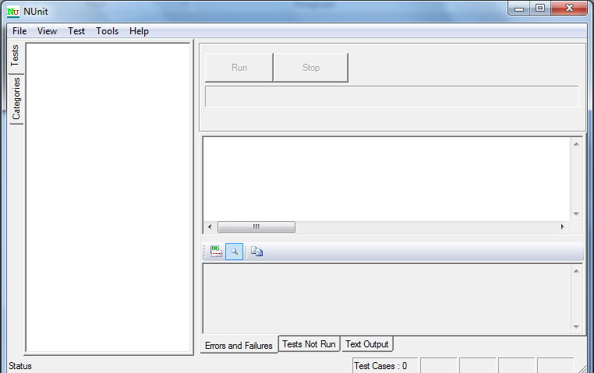
NUnit GUI
The NUnit GUI is divided into three main parts:
the tree listing the tests on the left
messages and errors at the top right
and stack trace information at the bottom right.

Slide 14
First Test
We’ll begin by testing the following simple class with one method (the unit we’re testing) inside it:
public class LogAnalyzer
{
public bool IsValidLogFileName(string fileName)
{
if(!fileName.EndsWith(".SLF"))
{
return false;
}
return true;
}
}

Slide 15
These are all done in the source code you have downloaded.
Here are the first steps for writing an automated test for the IsValidLogFileName method:
Add a new class library project to the solution, which will contain your test classes.
To that library, add a new class that will hold your test methods.
Add a new method to the preceding test case named IsValidLogFileName.

Slide 16
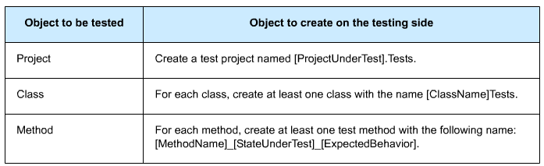
Naming test classes/methods/projects
For example, the name for our LogAn test project would be AOUT.Logan.Tests (with AOUT standing for Art of Unit Testing) . The name for the LogAnalyzer test class would be LogAnalyzerTests.
Our test method name might be IsValidFileName_validFile_ReturnsTrue()

Slide 17
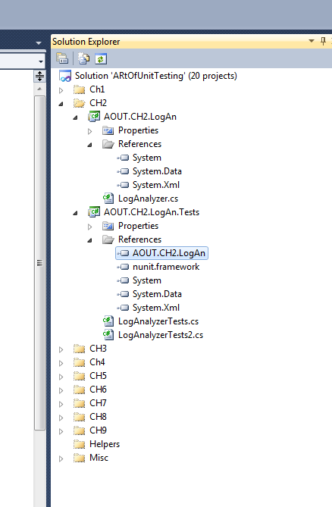
We have not used the NUnit test framework yet, but we’re close.
We still need to add a reference to the project under test for the new testing project.
Do this by right-clicking on the test project and selecting Add Reference. Then select the Projects tab and select the LogAn project. [This is done in the source code you have downloaded]
The next thing to learn is how to mark the test method to be loaded and run by NUnit automatically.
NUnit uses an attribute scheme to recognize and load tests. Just like bookmarks in a book….

Slide 18
NUnit provides an assembly that contains these special attributes.
You just need to add a reference in your test project (not in your production code!) to the NUnit.Framework assembly.
You can find it under the .NET tab in the Add Reference dialog box.
Type Nunit and you’ll see several assemblies starting with that name; add nunit.framework.

Slide 19
NUnit needs at least two attributes to know what to run:
[TestFixture] —The [TestFixture] attribute denotes a class that holds automated NUnit tests.
(If you replace the word “Fixture” with “Class”, it makes much more sense.) Put this attribute on your new LogAnalyzerTests class.
[Test] — The [Test] attribute can be put on a method to denote it as an automated test to be invoked. Put this attribute on your new test method.
[TestFixture] public class LogAnalyzerTests
{
[Test] public void IsValidFileName_validFile_ReturnsTrue()
{
}
}

Slide 20
How do we test our code?
A unit test usually comprises three main actions:
Arrange objects, creating and setting them up as necessary.
Act on an object.
Assert that something is as expected.

Slide 21
Here’s a simple piece of code that does all three actions.
The assert part is performed by the NUnit framework’s Assert class:
public void IsValidLogFileNameTest()
{
//arrange
LogAnalyzer analyzer = new LogAnalyzer();
//act
bool result = analyzer.IsValidLogFileName("whatever.slf");
//assert
Assert.IsTrue(result, "filename should be valid!");
}

Slide 22
The Assert class
The Assert class has static methods and is located in the Microsoft.VisualStudio.TestTools.UnitTesting namespace.
It’s the bridge between your code and the UnitTesting framework, and its purpose is to declare that a specific assumption is supposed to exist.
If the arguments that are passed into the Assert class turn out to be different than what we’re asserting, UnitTesting will realize the test has failed and will alert us.
We can optionally tell the Assert class what message to alert us with, if the assertion fails. (Exception Arguments)
The Assert class has many methods, with the main one being Assert.IsTrue (some Boolean expression), which verifies a Boolean condition.
(But there is more…) [next slides]

Slide 23
The Assert class (contd.)
Example 1:
Assert.AreEqual(2, 1+1, "Math is broken");
Example 2:
This one verifies that the two arguments reference the same object:
Assert.AreSame(expectedObject, actualObject, message)
Assert.AreSame(int.Parse("1"),int.Parse("1"), "this test should fail").

Slide 24
Running our first test with NUnit
To do that, we need to have a build assembly (a .dll file in this case) that we can give to NUnit to inspect.
After you build the project, locate the path to the assembly file that was built. Then, load up the NUnit GUI and select File > Open.
Enter the name of your test’s assembly. You’ll see your single test and the class and namespace hierarchy of your project on the left, as shown in next slide.
Click the Run button to run your tests.
As you can see, we have a failing test, which might suggest that there’s a bug in the code. It’s time to fix the code and see the test pass.

Slide 25
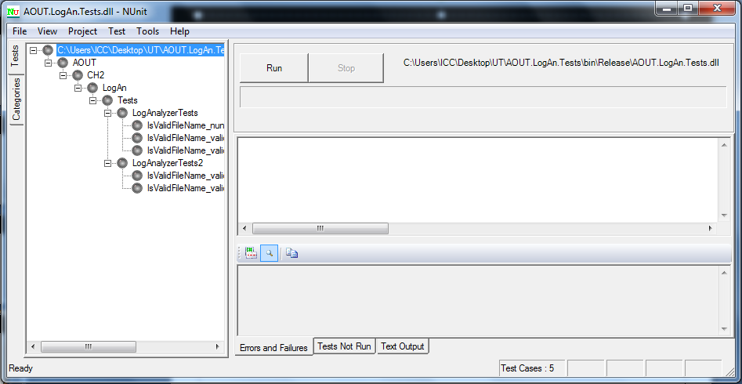
Namespace hierarchy of your project

Slide 26
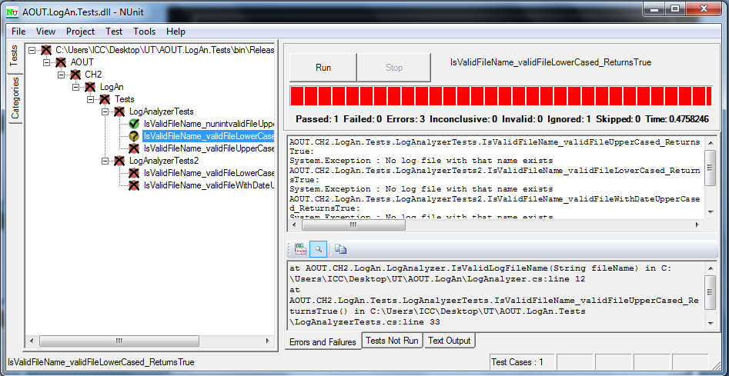
Test results:

Slide 27
Why test failed?
A quick look through the code reveals that we’re testing for an uppercase filename extension
and our test is sending in a lowercase filename extension, which makes our code return false instead of true.

Slide 28
If we fix the if statement in the production code to look like this, we can make the test pass:
if(! fileName. ToLower(). EndsWith(". slf"))
But this is a sign that the name of our test may need changing, and that we need another test to make sure that sending in an uppercase extension works.
(We know that it works now, but who’s to say that some programmer working on this feature won’t break it in the future?) A better name for our current test might be:
IsValidFileName_validFileLowerCased_ReturnsTrue() .

Slide 29
NUnit detect changes in the original code
If you rebuild the solution now, you’ll find that NUnit’s GUI can detect that the assembly has changed.
It will automatically reload the assembly in the GUI.
If you rerun the tests, you’ll see that the test passes with flying (green) colors.

Slide 30
Initialize and Cleanup (1)
For unit tests, it’s important that any leftover data or instances from previous tests are destroyed and that the state for the new test is recreated as if no tests have been run before.
If you have leftover state from a previous test, you might find that your test fails.
In NUnit, there are special attributes that allow easier control of setting up and clearing out state before and after tests.
These are the [ SetUp] and [TearDown] action attributes.

Slide 31
NUnit performs setup and teardown actions before each and every test method.
We can take control of what happens in the setup and teardown steps by using two NUnit attributes:
[SetUp] —This attribute can be put on a method, just like a [ Test]attribute, and it causes NUnit to run that setup method each time it runs any of the tests in your class.
[TearDown] —This attribute denotes a method to be executed once after each test in your class has executed.

Slide 32
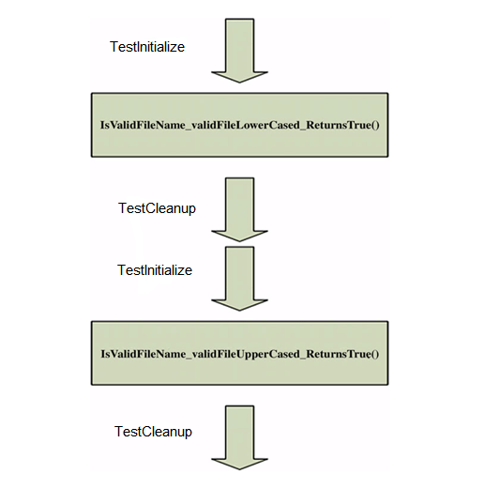
The following show how we can use the [SetUp] and [TearDown] attributes to make sure that each test receives a new instance of LogAnalyzer, while also saving some repetitive typing.
public class LogAnalyzerTest
{
private LogAnalyzer m_analyzer=null;
[TestInitialize]
public void Setup()
{
m_analyzer = new LogAnalyzer();
}
[TestMethod]
public void IsValidFileName_validFileLowerCased_ReturnsTrue()
{
bool result = m_analyzer.IsValidLogFileName("whatever.slf");
Assert.IsTrue(result, "filename should be valid!");
}
[TestMethod]
public void IsValidFileName_validFileUpperCased_ReturnsTrue()
{
bool result = m_analyzer.IsValidLogFileName("whatever.SLF");
Assert.IsTrue(result, "filename should be valid!");
}
[TestCleanup]
public void TearDown()
{
m_analyzer = null;
}
}
}
You can think of the setup and teardown methods as:
constructors and destructors for the tests in your class.
You can only have one of each in any test class, and each one will be performed once for each test in your class.

Slide 33
ArgumentException
One common testing scenario is making sure that the correct exception is thrown from the tested method when it should be.
Let’s assume that our method should throw an ArgumentException when we send in an empty filename.
public bool IsValidLogFileName(string fileName)
{
if (String.IsNullOrEmpty(fileName))
{
throw new ArgumentException("No filename provided!");
}
if (!fileName.ToLower().EndsWith(".slf"))
{
return false;
}
return true;
}

Slide 34
ArgumentException
There’s a special attribute in NUnit that helps us test exceptions and that is the [ExpectedException] attribute.
Here’s what a test that checks for the appearance of an exception might look like:
[TestMethod]
[ExpectedException(typeof(ArgumentException))]
public void IsValidFileName_EmptyFileName_ThrowsException()
{
m_analyzer.IsValidLogFileName(string.Empty);
}

Slide 35
Ignoring tests
Sometimes you’ll have tests that are broken.
In those rare cases (and they should be rare! ), you can put an [Ignore] attribute on tests that are broken because of a problem in the test, not in the code.
[Test]
[Ignore("there is a problem with this test")]
public void IsValidFileName_ValidFile_ReturnsTrue()
{
/// ...
}

Slide 36
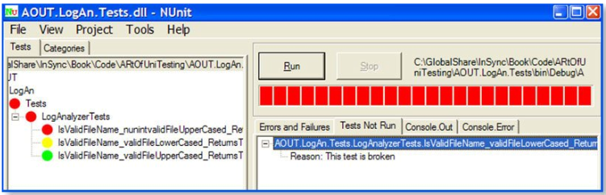
Ignoring tests
In NUnit, an ignored test is marked in yellow (the middle test), and the reason for not running the test is listed under the Tests Not Run tab on the right.

Slide 37
Unit Testing from within Visual Studio 2010
With the latest release of Visual Studio Test System (VSTS) comes a full suite of functionality for Visual Studio Team Test (TT). [See the third reference in the last slide].
Team Test is a Visual Studio integrated unit-testing framework that enables:
Code generation of test method stubs.
Running tests within the IDE.
Incorporation of test data loaded from a database.
Code coverage analysis once the tests have run.
Now that we know the structure and format of tests in C# and the way they are run by NUnit it is easy to understand how Unit Testing works in VS 2010.

Slide 38
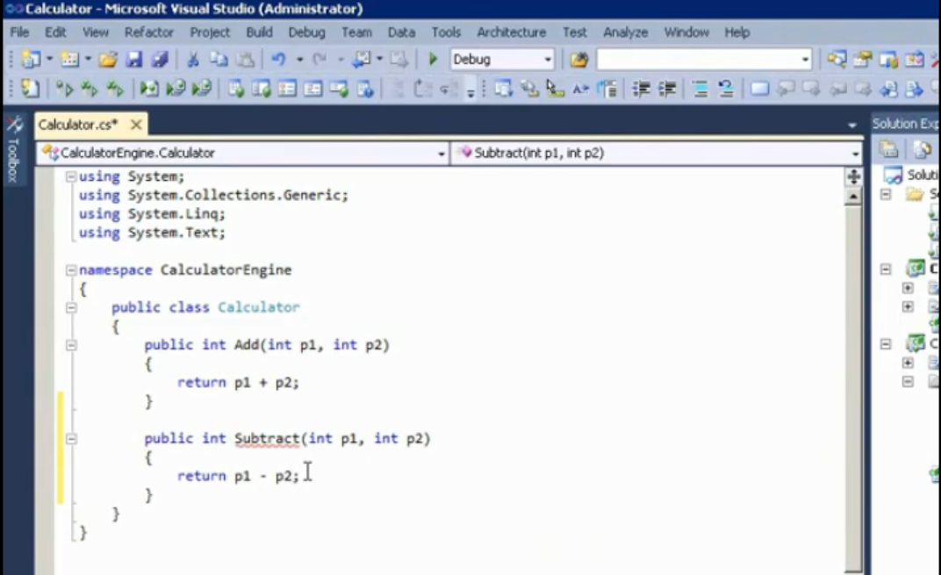
Visual Studio 2010 (Much easier than NUnit) Let’s write a test code for the following Solution.
First add a new class to your project (Right click on the project name select Add and the select Class
Now put the following two methods in it.

Slide 39
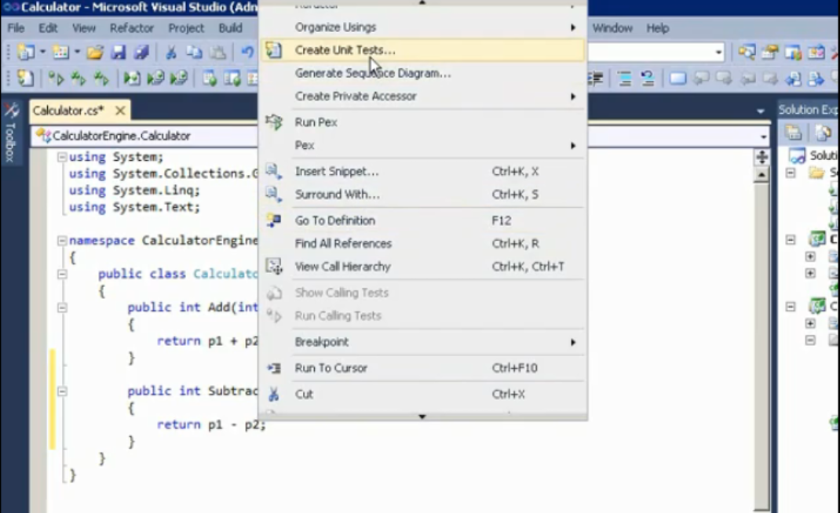
Right click inside the scope of the function that you want to be tested and …

Slide 40
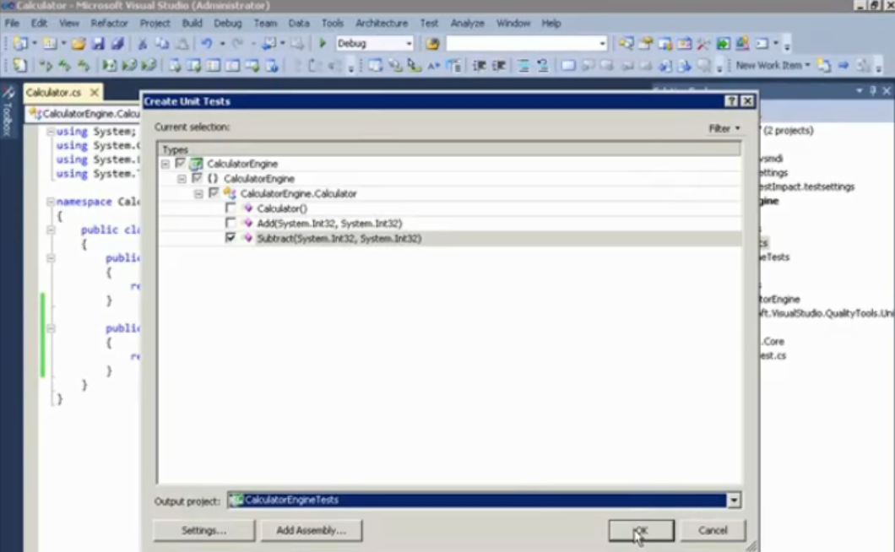

Slide 41
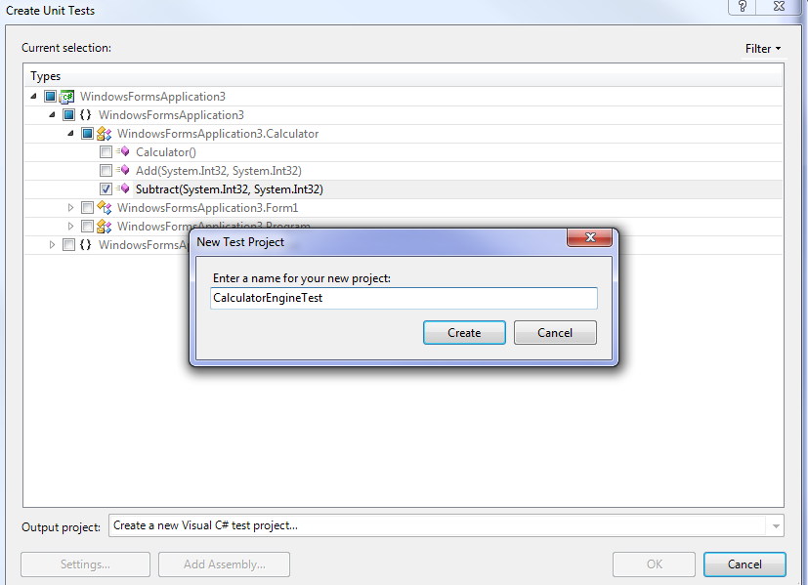
Give it a name if you were asked to.

Slide 42
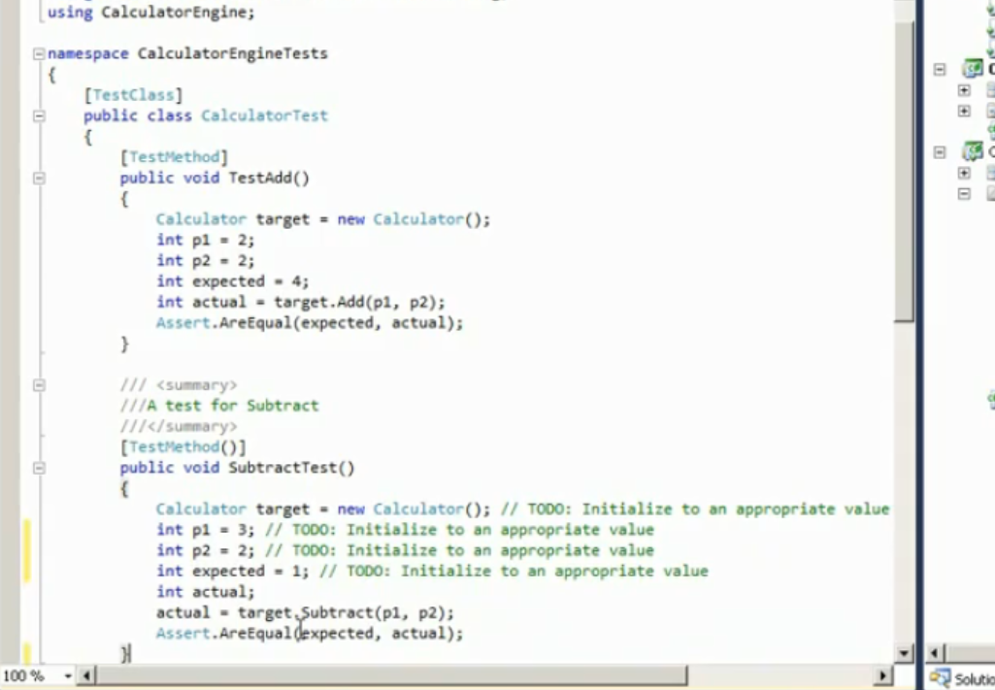
SubtractTest (automatically generated)

Slide 43
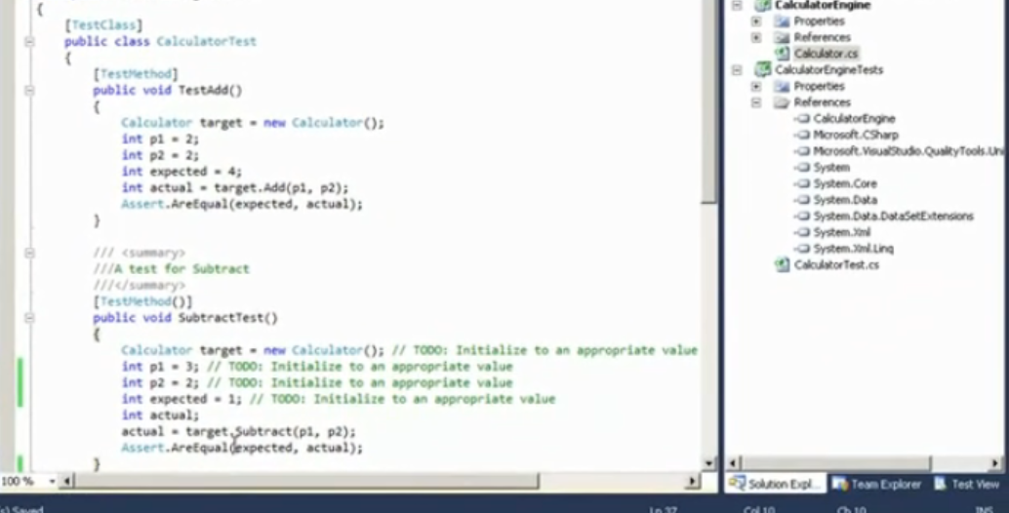
Go to the Test View

Slide 44
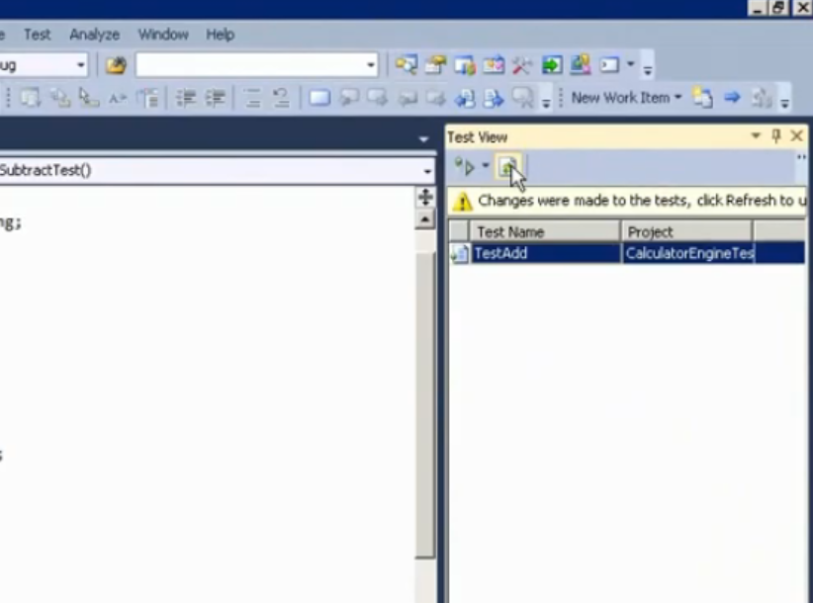
Before running the tests, refresh the test list

Slide 45
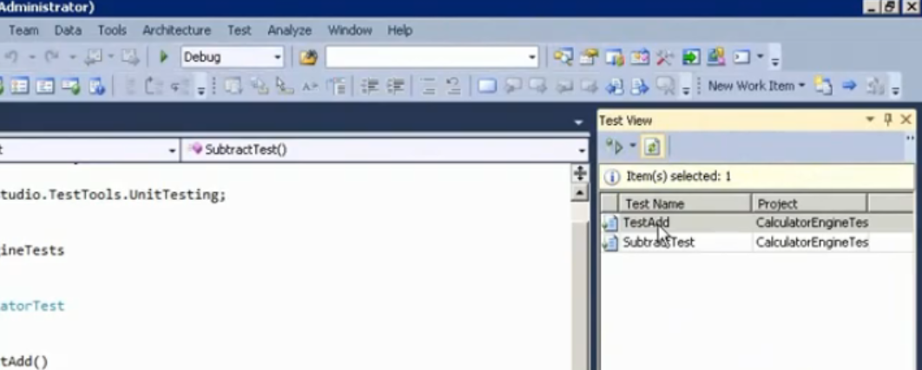
Test list refreshed (updated)

Slide 46
Unit Testing in Java
The commonly used framework for unit testing in Java is JUnit.
You can get it as a jar file from www.junit.org.
It is an integrated part of the Eclipse IDE.
To write unit tests, we should first create a Java project.
It is a good practice to put tests inside a separate folder.

Slide 47
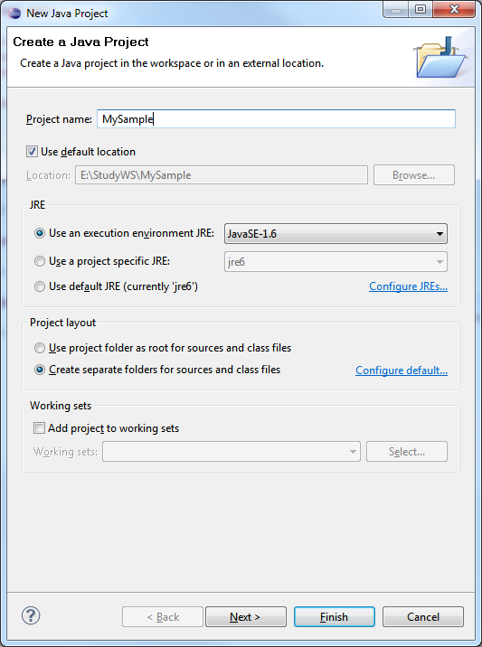
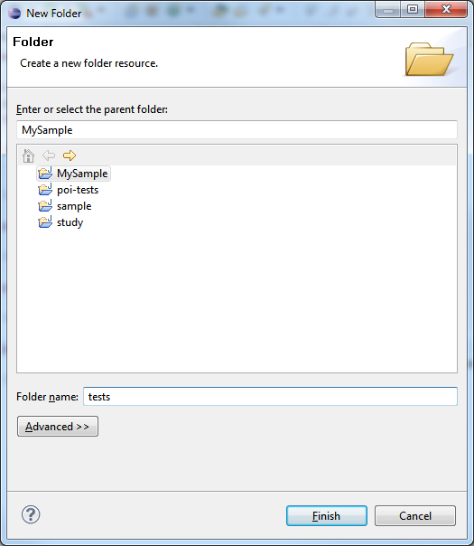
Unit Testing in Java using Eclipse (1)
First create a Java project.
Then right click on the project name in the package explorer and create a new folder for tests.

Slide 48
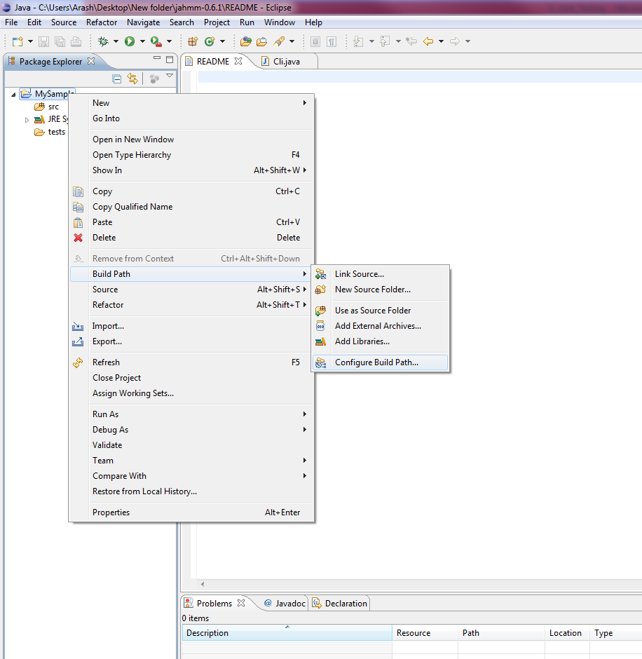
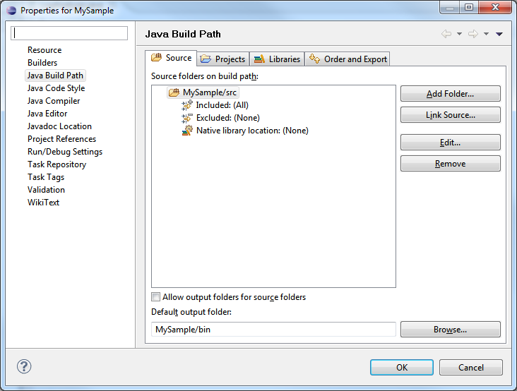
Unit Testing in Java using Eclipse (2)
The “test” folder must be on the build path. Add it to the build path by selecting Build path->Configure build path. Then go to the “Source” tab and add the folder.

Slide 49
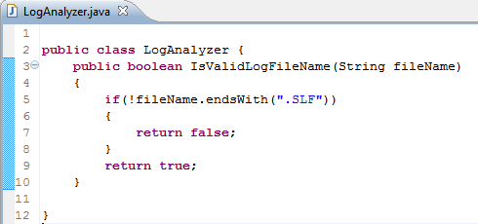
Unit Testing in Java using Eclipse (3)
Create a Class in the “src” folder.

Slide 50
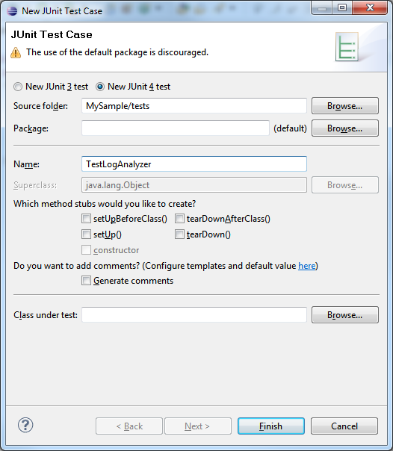
Unit Testing in Java using Eclipse (4)
Then we need to create a JUnit test by selecting New->Junit Test Case.
We should put it in the “test” folder.

Slide 51
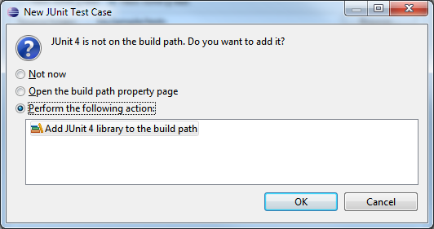
Unit Testing in Java using Eclipse (5)
Eclipse will ask us to add JUnit 4 to the build path. Press OK to add it.

Slide 52
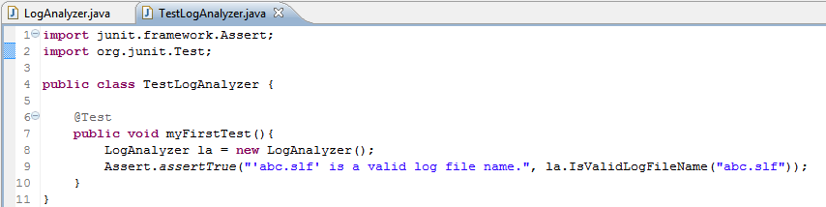
Unit Testing in Java using Eclipse (6)
Each test method is marked with @Test annotation.

Slide 53
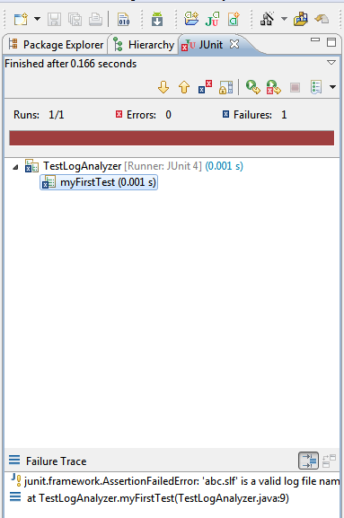
Unit Testing in Java using Eclipse (7)
To run the test right click on the test file and select Run As -> JUnit Test. The test should fail (red/brown line in the JUnit tab).
After fixing the problem in the source code, we will get a green line.
What do you think the problem is?
.SLF vs. .slf

Slide 54
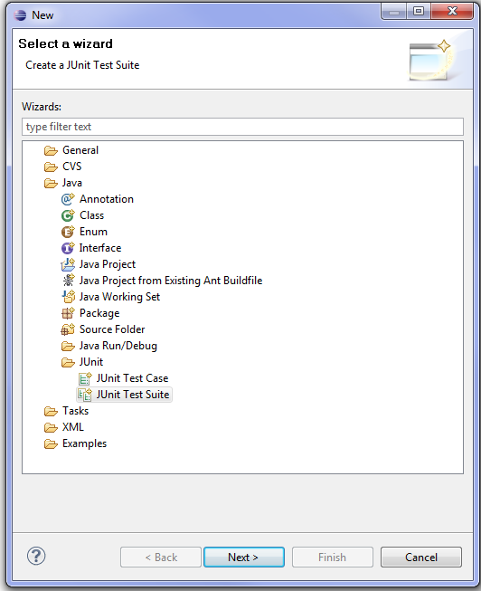
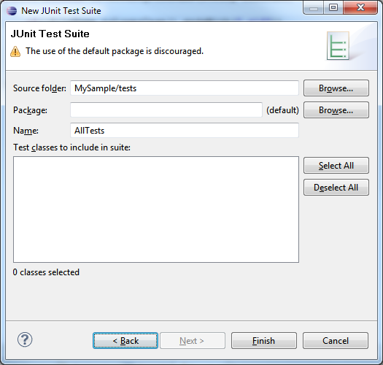
Unit Testing in Java using Eclipse (8)
If we have a set of test cases and want to run all of them with one click, we should create a Test Suite.
Select all your test classes, then right click and select New->Other..->JUnit Test Suite. (Does not work for JUnit 4.)

Slide 55
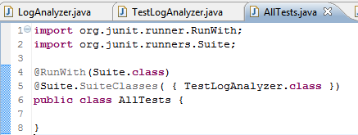
Unit Testing in Java using Eclipse (9)
Change the generated file like this.
Then run it like a normal JUnit test.

Slide 56
2) Eclipse general skills and practice

Slide 57
IDE Overview
An IDE is an Interactive Development Environment
Different IDEs meet different needs
BlueJ and DrJava are designed as teaching tools
- Emphasis is on ease of use for beginners
- Little to learn, so students can concentrate on learning Java
Eclipse, JBuilder and IntelliJ are designed as professional-level work tools
- Emphasis is on supporting professional programmers
- More to learn, but well worth it in the long run
We will use Eclipse

Slide 58
Eclipse Overview
Eclipse Platform
Another
Tool
Java
Development
Tools
(JDT)
Workbench
Help
JFace
SWT
Team
Your
Tool
Plug-in
Development
Environment
(PDE)
Workspace
Debug
Platform Runtime
Their
Tool
Eclipse Project

Slide 59
What is Eclipse?
Eclipse is a universal platform for integrating development tools
Open, extensible architecture based on plug-ins
Plug-in development environment
Java Development Tools
Eclipse Platform
Java Virtual Machine

Slide 60
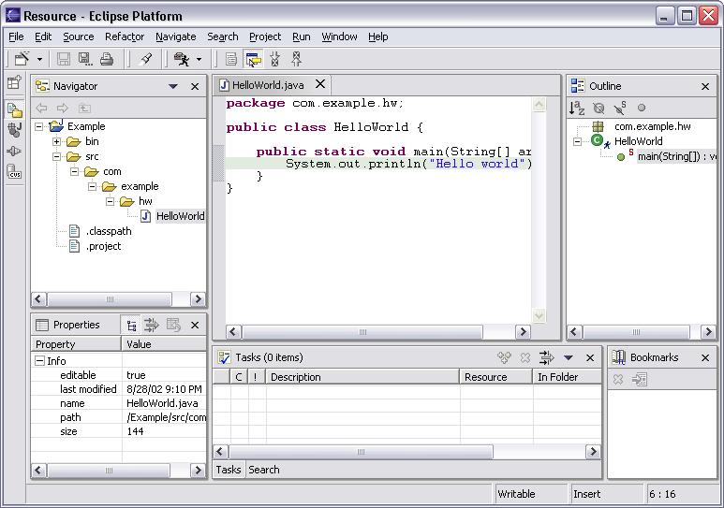
Workbench Terminology
Click to display the label…
Menu bar
Text
editor
Tool bar
Perspective
and
Fast View
bar
Outline
view
Resource
Navigator
view
Properties
view
Bookmarks
view
Editor
Status
area
Stacked
views
Tasks
view
Notes:
Faculty Note:
Click on the various sections of the graphic on the slide to view the labels of each section. I.e., Click on the Menu bar for the Menu Bar label to pop up.

Slide 61
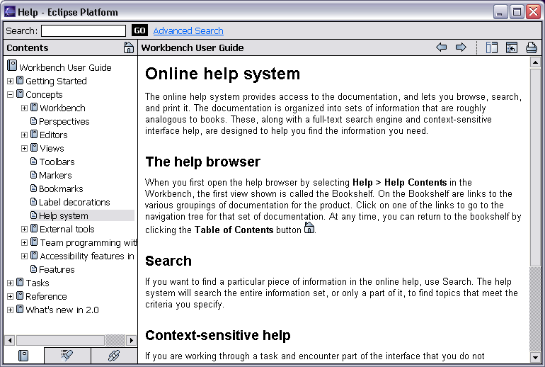
Help Component
Help is presented in a standard web browser

Slide 62
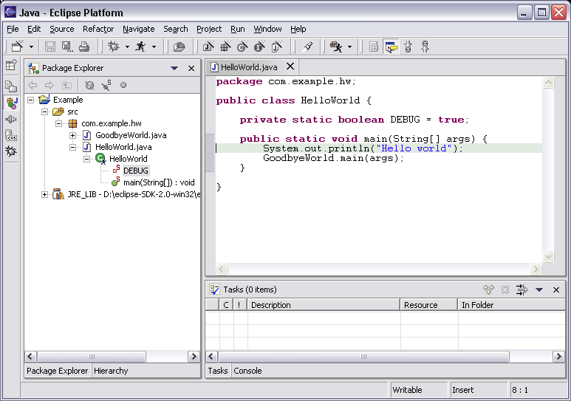
Java Perspective
Java-centric view of files in Java projects
Java elements meaningful for Java
Java project
package
class
Java editor
field
method

Slide 63
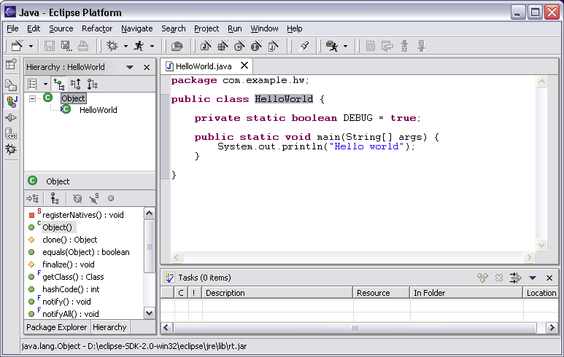
Java Perspective
Browse type hierarchies
“Up” hierarchy to supertypes
“Down” hierarchy to subtypes
Type hierarchy
Selected type’s members

Slide 64
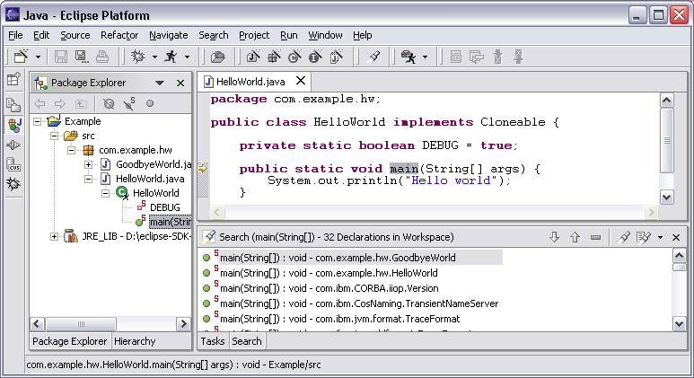
Java Perspective
Search for Java elements
Declarations or references
Including libraries and other projects
Hits flagged in margin of editor
All search results

Slide 65
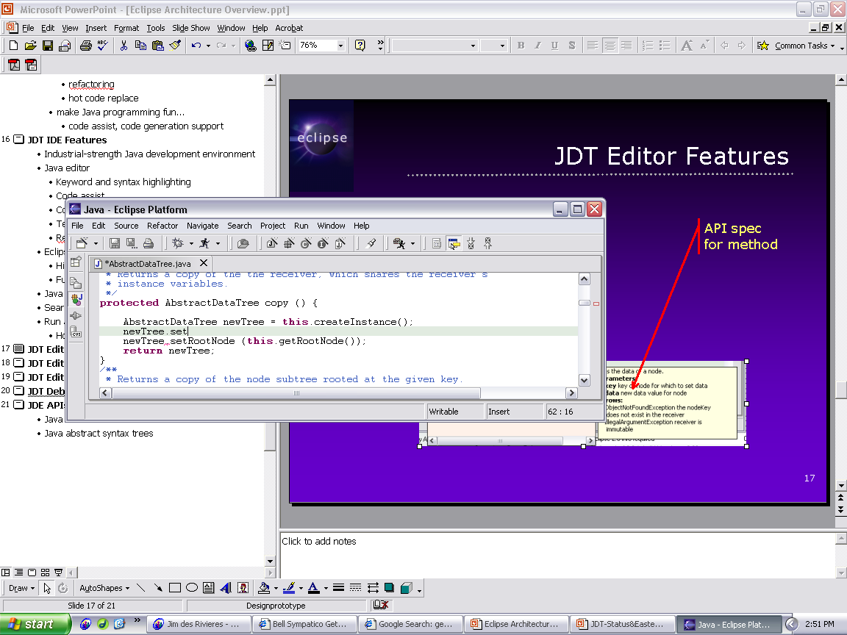
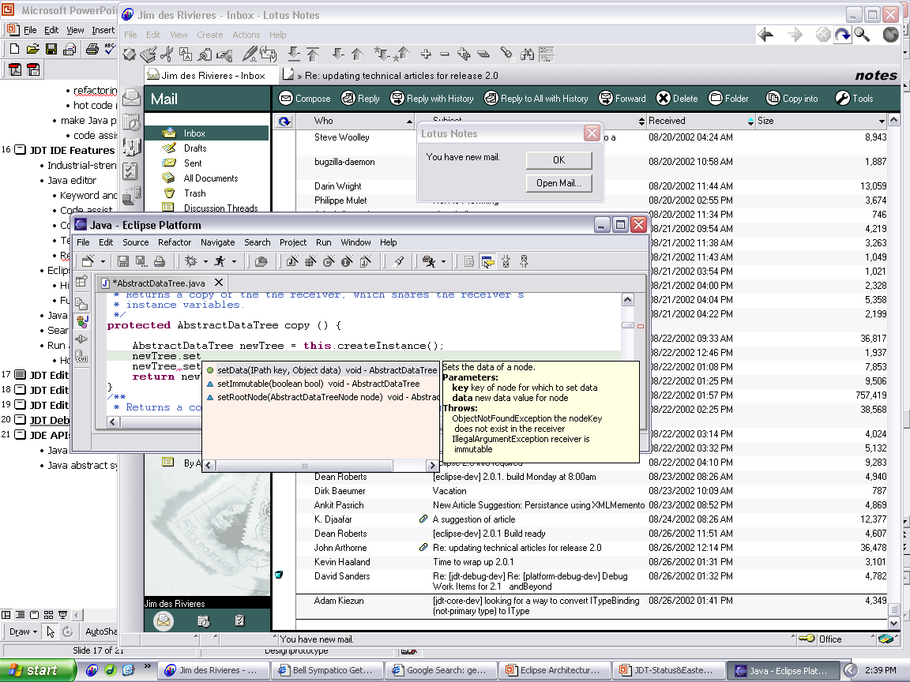
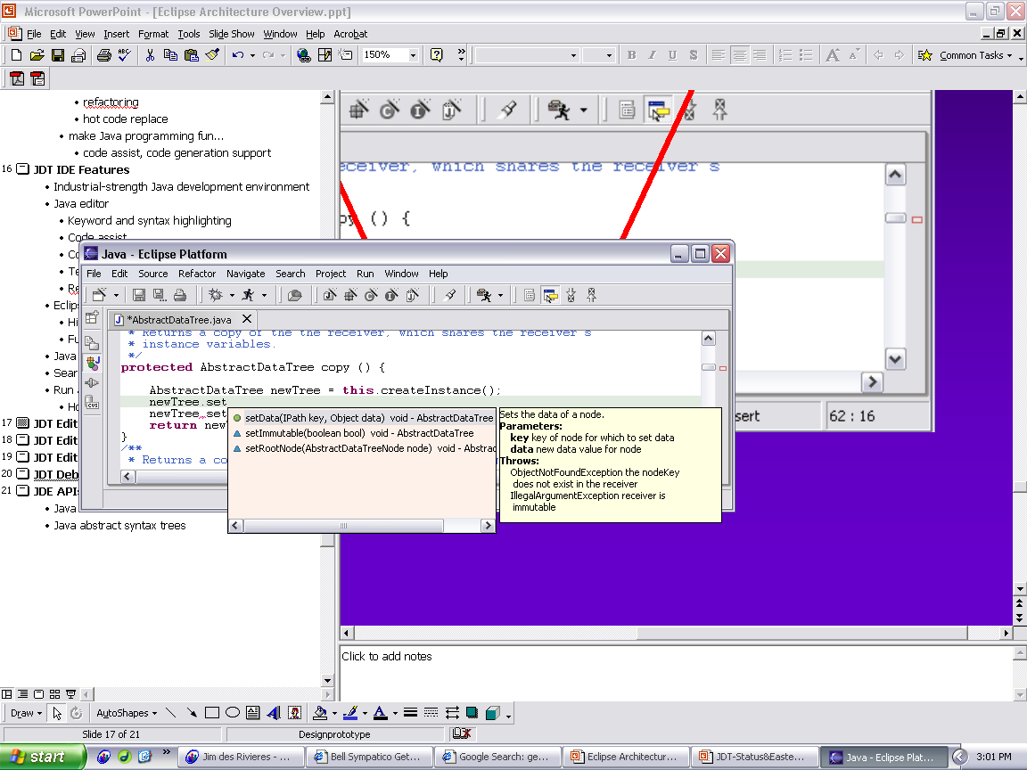
Java Editor
Hovering over identifier shows Javadoc spec
Method completion in Java editor
List of plausible methods
Doc for method

Slide 66
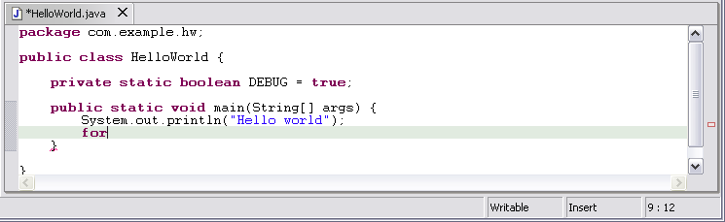
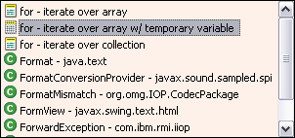
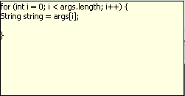
Java Editor
On-the-fly spell check catches errors early
Code templates help with drudgery
Statement template
Preview

Slide 67
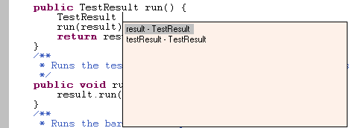
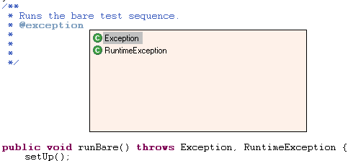
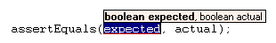
Java Editor
Java editor creates stub methods
Java editor helps programmers write good Java code
Variable name suggestion
JavaDoc code assist
Argument hints and proposed argument names

Slide 68
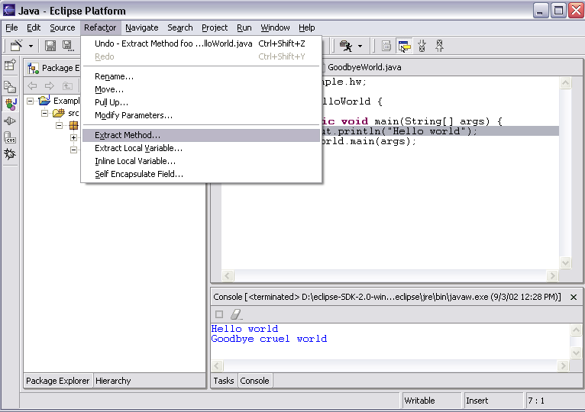
Refactoring
JDT has actions for refactoring Java code

Slide 69
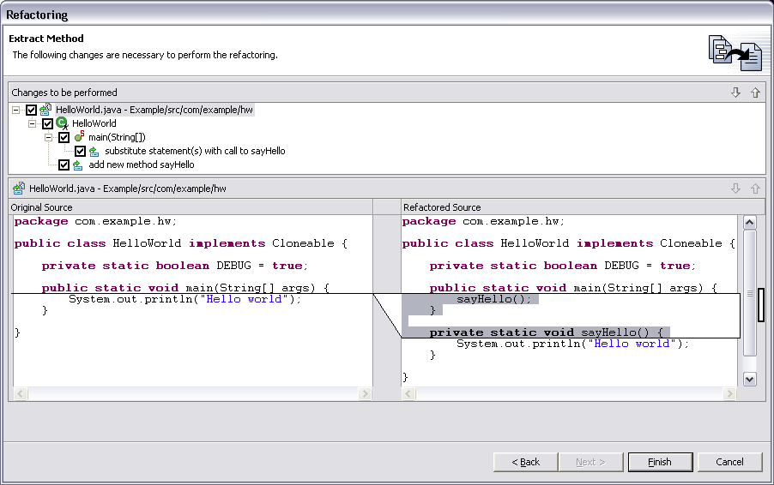
Refactoring
Full preview of all ensuing code changes
Programmer can veto individual changes
List of changes
“before” vs. “after”
Notes:
Screen shot shows Extract Method applied to the print statement in HelloWorld.main method.

Slide 70
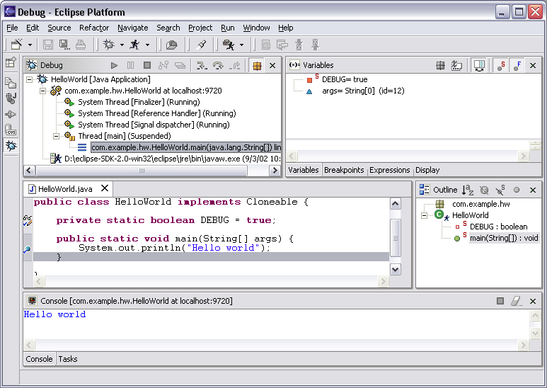
Eclipse Java Debugger
Local variables
Run or debug Java programs
Threads and stack frames
Editor with breakpoint marks
Console I/O

Slide 71
Contents
How To Create Java Project
How To Add Folder
How To Configure Java Project
How To Create Java Package
How To Create Java Application
How To Run Java Application
How To Debug a Java Application
Configuring Library Build Path
Resources

Slide 72

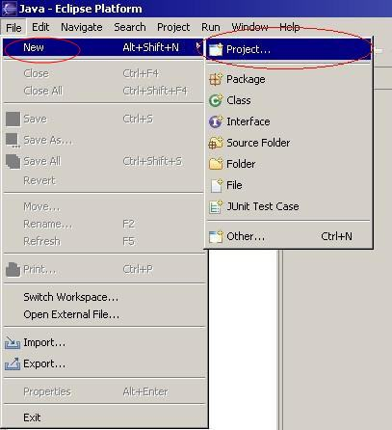
How To Create Java Project
Double-click the Eclipse icon on your desktop.
Select File → New → Project…

Slide 73
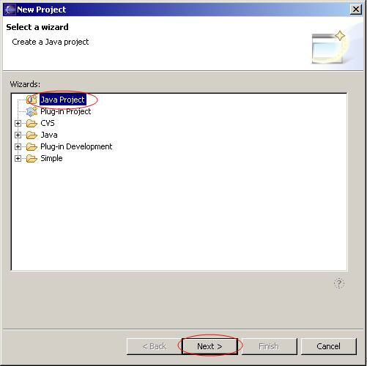
How To Create Java Project
Select Java Project in the ‘New Project’ window.
Click Next.

Slide 74
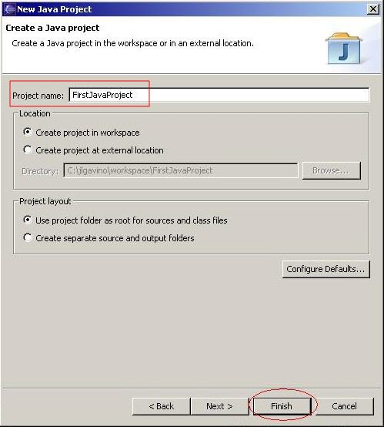
How To Create Java Project
Choose a non-existing name for the project. In this example, choose ‘FirstJavaProject’.
Click Finish.
Back to Main

Slide 75
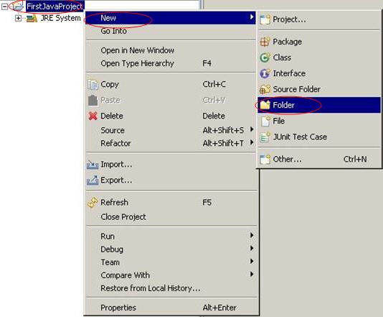
How To Add Folder
For example, you need to add lib, src and classes folder:
1. Right-click the project name, in this example, FirstJavaProject. Select New → Folder…

Slide 76
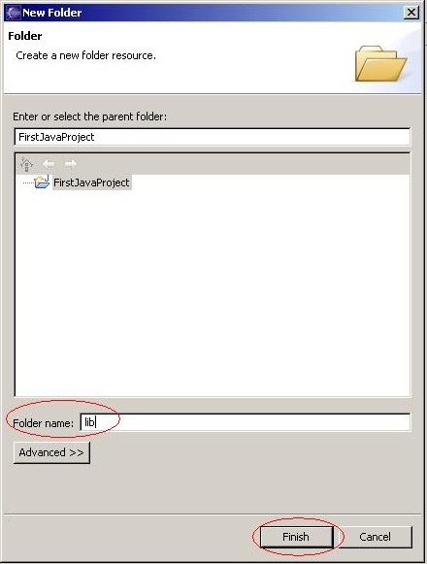
How To Add Folder
Enter lib in the ‘Folder name’ textbox of the ‘New Folder’ dialog box.
Click Finish.
Repeat steps 1 to 3 to add src and classes folder.
Back to Main

Slide 77
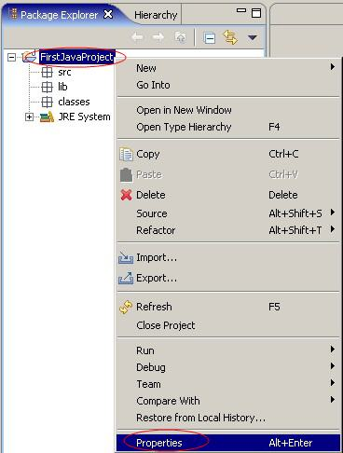
How To Configure Java Project
Right-click the project name, in this example, FirstJavaProject.
Select Properties.

Slide 78

How To Configure Java Project
Select Java Build Path in the ‘Properties’ dialog box. Configure the following:
1. Source → set to ‘src’ folder.
Click the Add Folder… button. The ‘Source Folder Selection’ dialog box appears. Select the ‘src’ folder. Click OK.

Slide 79

How To Configure Java Project
2. Set the default output folder to FirstJavaProject\ classes
Click the Browse… button. The ‘Folder Selection’ dialog box appears. Select the classes folder.
Click OK.
NOTE:
Default output folder would be changed to FirstJavaProject\ classes
Back to Main

Slide 80

How To Create Java Package
Select File → New → Package

Slide 81

How To Create Java Package
Enter the package name, firstJavaPackage, in the ‘Name’ textbox of the ‘New Java Package’ dialog box.
Click Finish.
Back to Main

Slide 82

How To Create Java Class
To create a Java Class, right-click the package name, in this example, firstJavaPackage.
Select New → Class

Slide 83

How To Create Java Class
The ‘New Java Class’ dialog box appears. Enter the class name in the ‘Name’ text box. For this instance enter ‘Example’.
Click Finish.

Slide 84

How To Create Java Class
Complete the Java Class in the Java editor screen…
Back to Main

Slide 85

How To Run Java Class
To run the class, select the Java File.
On the Menu bar, select Run → Run As → Java Application
This will show the results on the Console view.
Back to Main

Slide 86

How To Debug a Java Application
Right-click the JavaMainClass, in this example, TestCard.java
Select Debug →Java Application.
The Debug perspective screen will appear.

Slide 87

How To Debug a Java Application

Slide 88

How To Debug a Java Application
Set Breakpoints
Place your cursor on the marker bar (along the left edge of the editor area) on the line including the suspected code.
Double-click to set the breakpoint
NOTE:
Two breakpoint markers in the left margin of the editor.

Slide 89

Configuring Library Build Path
How to add jar files
Right-click the project name, in this example, “Sample” project.
Select Properties.

Slide 90

Configuring Library Build Path
In the ‘Properties’ dialog box, select the ‘Libraries’ tab.
Click the Add External … button

Slide 91

Configuring Library Build Path
In the ‘JAR Selection’ dialog box, select the ‘plugins’ folder.
Click the Open button.
OR
Double-click the ‘plugins’ folder.

Slide 92

Configuring Library Build Path
In the ‘JAR Selection’ dialog box, look for the specific ‘junit’ folder with the required version. In this example we are using junit 3.8.1.
After selection, Click the Open button
OR
Double Click the selected junit folder.

Slide 93

Configuring Library Build Path
Select the ‘junit.jar’ file in the ‘JAR Selection’ dialog box.
Click the Open button.
OR
Double-click the selected ‘junit’ folder.

Slide 94

Configuring Library Build Path
You should see that the ‘jar’ file has been added to the ‘Properties’ dialog box..
Click OK.
Back to Main

